Slide 1
Scalable Label Distribution Learning for Multi-Label Classification
Xingyu Zhao, Yuexuan An, Lei Qi, Xin Geng
School of Computer Science and Engineering, Southeast University, Nanjing 211189, China
Key Laboratory of New Generation Artificial Intelligence Technology and Its Interdisciplinary
Applications (Southeast University), Ministry of Education, China
Presentation：Chen Ning
Supervisor：Shen-Huan Lyu
Date: 6/2/2024

Slide 2
Table of Contents
1
Introduction
2
Related Work
3
Proposed Method
4
Experiments
5
Conclusion

Slide 3
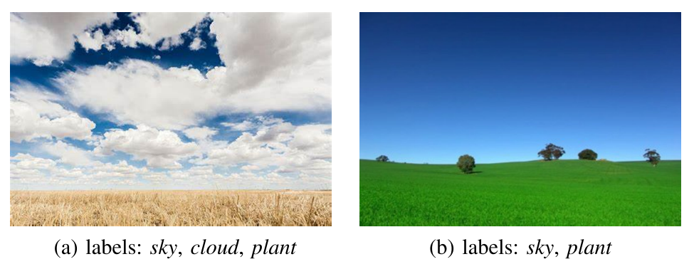
Questions
Most of the existing multi-label classification methods are based on the assumption that the correlation between two labels in each label pair is symmetric, but this cannot cover all scenarios in the real world. For example, clouds appear in the sky, and clouds and sky are a pair of labels. However, these two labels are asymmetric, because there may be no clouds in the sky. In addition, the learning process designed by the current method is related to the number of labels, which increases the computational complexity, especially when the number of labels increases sharply.

Slide 4
Method and Contributions
Method
This paper proposes a novel method called Scalable Label Distribution Learning (SLDL)
This method constructs a latent label distribution space where the relationships between labels can be asymmetric, and the dimension is independent of the number of labels.
Contributions
It is a scalable and effective solution for multi-label classification tasks with a large output space.
It represents different labels in a potentially low-dimensional Gaussian embedding space and proposes a asymmetric metric to effectively capture the accurate relationships between different labels.
It introduces a simple yet effective method to learn the mapping from the feature space to the potentially low-dimensional embedding space, where the computational complexity is no longer related to the number of labels.

Slide 5
Table of Contents
1
Introduction
2
Related Work
3
Proposed Method
4
Experiments
5
Conclusion

Slide 6
Multi-Label Classification
Traditional multi-label classification approaches fall into three main categories based on label correlation order: first-order, second-order, and high-order approaches
first-order
First-order methods treat multi-label classification as independent binary classification tasks, neglecting potential information sharing among labels and overlooking the mutual benefits of knowledge gained from one label for learning other labels.
second-order
Second-order approaches, focus on pairwise label correlations, emphasizing differences between relevant and irrelevant labels without fully leveraging relationships among multiple labels.
high-order
High-order methods extend beyond pairwise correlations to consider relationships among label subsets or all class labels, aiming for a more comprehensive label space representation.

Slide 7
Multi-Label Classification
The Question Of Traditional Method
a common limitation is their assumption of equal label importance
Resolution
assign different weights to labels based on class frequencies.
Bring A New Question
related methods rely on manually designed rules and lack the ability to dynamically adjust label importance based on specific instances.
overlook correlations among different labels.

Slide 8
Multi-Label Classification
The Condition Of Large-Scale Output Space
Existing approaches can be categorized into four types: One-vs-all、Tree-based、Embedding-based、Deep learning-based methods.
One-vs-all
employ a separate binary classifier for each label when classifying a new instance.
Tree-based
adopt decision tree principles
Embedding-based
reduce the effective number of labels by projecting label vectors into a lower-dimensional space.
Deep learning-based methods
incorporate the latest deep learning technologies into large-scale output space classification.

Slide 9
Multi-Label Classification
Question
most existing multi-label classification methods link the learning process to the number of labels.
neglect to capitalize on asymmetric correlations among different labels

Slide 10
Label Distribution Learning
Label Distribution Learning (LDL) has emerged as a promising paradigm for uncovering correlations among different labels, assigning a label distribution to an instance and directly learning a mapping from instance to label distribution. LDL can be categorized into three main groups: global label correlation, local label correlation, and both global and local label correlations.
Question
computational complexity of LDL is generally higher than traditional learning frameworks.
neglect to leverage asymmetric correlations among different labels, which further limits the performance of the model.

Slide 11
Table of Contents
1
Introduction
2
Related Work
3
Proposed Method
4
Experiments
5
Conclusion

Slide 12
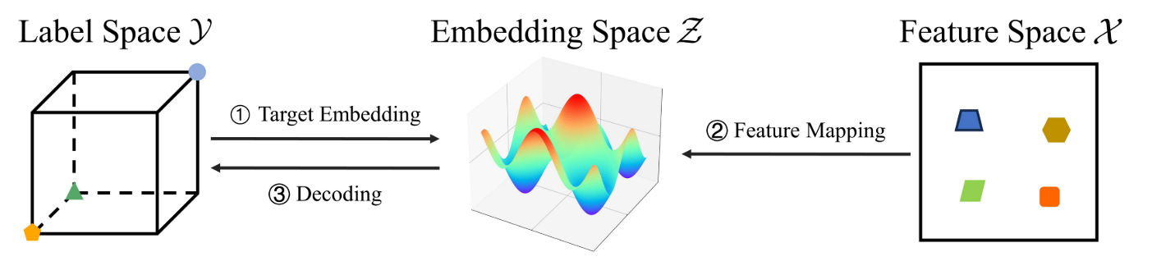
Overview
Scalable Label Distribution Learning(SLDL) incorporates the target embedding method, aiming to reduce label dimensionality and mitigate resource requirements during model training. Subsequently, SLDL learns the mapping from the instance to the low-dimensional embedding vector. During the prediction phase, the output score is decoded from the predicted embedding vector using a nearest neighbor-based strategy.

Slide 13
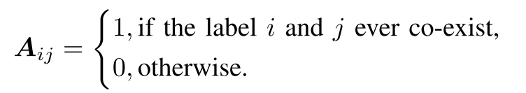
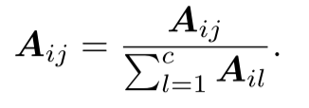
Asymmetric-Correlational Gaussian Embedding
In SLDL, we use Gaussian embedding to extract asymmetric correlations. To learn a reasonable transition relationship between different labels, we construct a probability transfer matrix. Each label is treated as a multivariate Gaussian distribution, and an asymmetric metric is employed to
establish the asymmetric correlation between each pair of labels. To gain probability transfer matrix, we first construct a label correlation matrix A.
For each row, we normalize the label correlation vector:

Slide 14
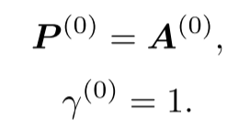
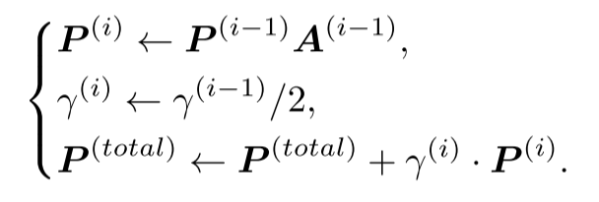
Asymmetric-Correlational Gaussian Embedding
In order to effectively establish the correlation between different labels, we leverage random walk simulation and aggregate the accumulated values. The parameters of random walk simulation are initialized as
Subsequently, we perform the random walk processes several times and obtain the accumulated probability transfer matrix P^{(total)}

Slide 15
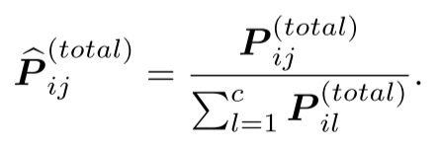
Asymmetric-Correlational Gaussian Embedding
After that, we standardize the accumulated probability transfer matrix:

Slide 16
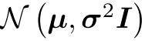
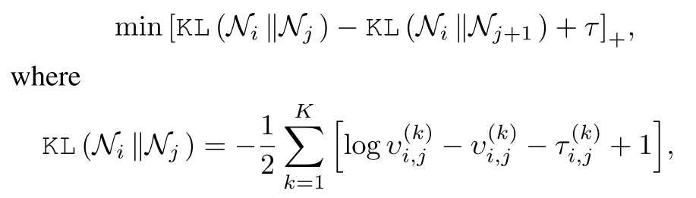
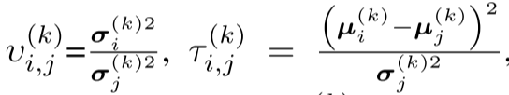
Asymmetric-Correlational Gaussian Embedding
We assume each label as a multivariate Gaussian distribution with a diagonal covariance structure
We follow a multi-round optimization to generate reasonable distribution for each label.

Slide 17
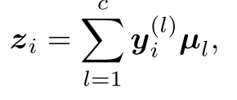
Asymmetric-Correlational Gaussian Embedding
Then, for a specific instance i, we leverage the learned Gaussian embedding and its label vector to obtain its embedding vector:

Slide 18
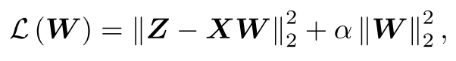
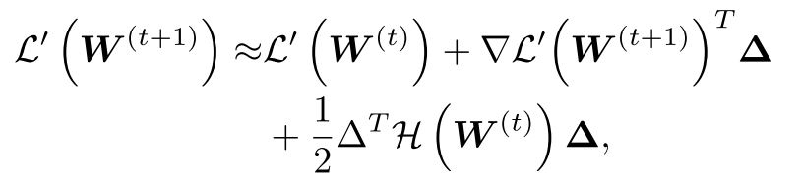
Model Training and Prediction
We optimize the following simple yet effective objective function to obtain the model parameter:
We utilize the Limited-memory Broyde-Fletcher-Goldfarb-Shanno (L-BFGS) algorithm to minimize the above function.

Slide 19
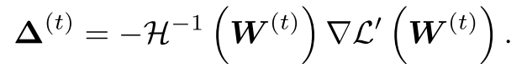
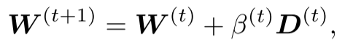
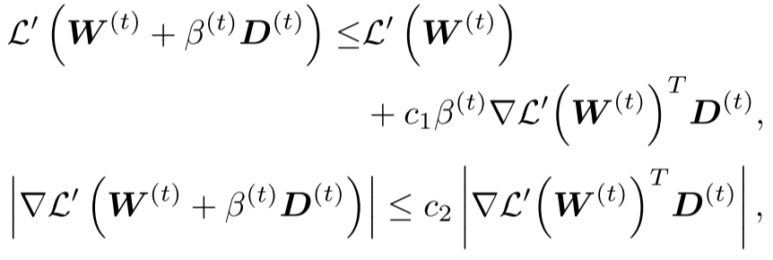
Model Training and Prediction
Then the minimizer of above equation is:
The line search Newton method utilizes ∆^{(t)} as the search direction, denoted as D^{(t)} = ∆^{(t)}, and the model parameters are updated using:
We where the step length β(t) is determined through a line search procedure to satisfy the strong Wolfe conditions:

Slide 20
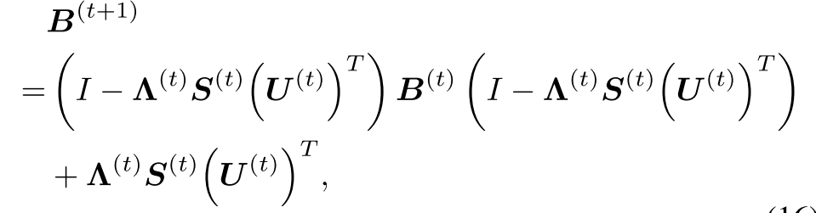
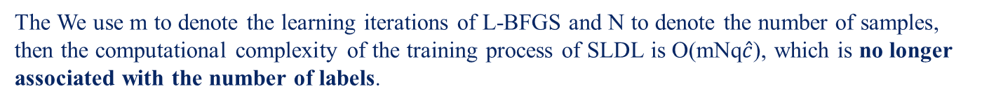
Model Training and Prediction
The L-BFGS algorithm aims to avoid the explicit calculation of H⁻¹(W^{(t)}) by approximating it with an iteratively updated matrix B
The We use m to denote the learning iterations of L-BFGS and N to denote the number of samples, then the computational complexity of the training process of SLDL is O(mNq$\hat{c}$), which is no longer associated with the number of labels.

Slide 21
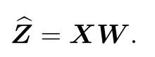
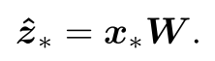
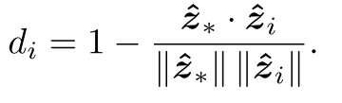
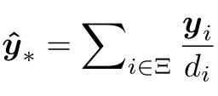
Model Training and Prediction
In the prediction process, SLDL first calculate the embedding matrix $\hat{z}$ of training samples transformed by W:
For a new sample x∗, SLDL first calculates its corresponding target vector in the embedding space
After that, a decoder is employed to map the target embedding vector to the predicted label vector
Subsequently, by utilizing the reciprocal of the cosine distance as the weight

Slide 22
Theoretical Analysis
We study the theoretical guarantees of SLDL to reveal the effectiveness of Gaussian embedding with asymmetric metrics below

Slide 23
Table of Contents
1
Introduction
2
Related Work
3
Proposed Method
4
Experiments
5
Conclusion

Slide 24
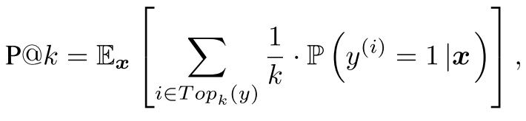
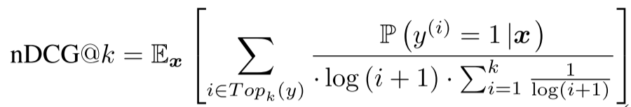
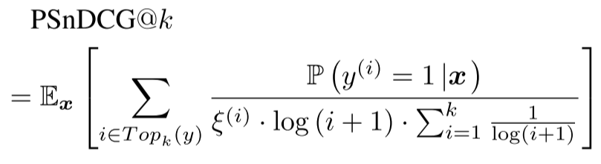
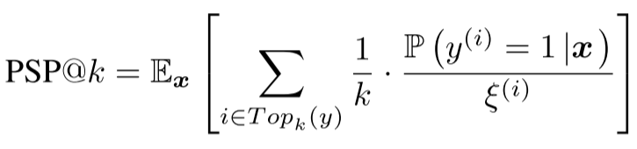
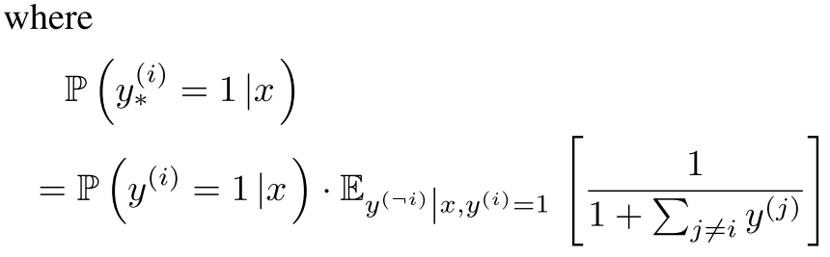
Evaluation Metrics
The metrics include Precision (P@k), nDCG (nDCG@k), Propensity Scored precision (PSP@k), and Propensity Scored nDCG (PSnDCG@k)

Slide 25
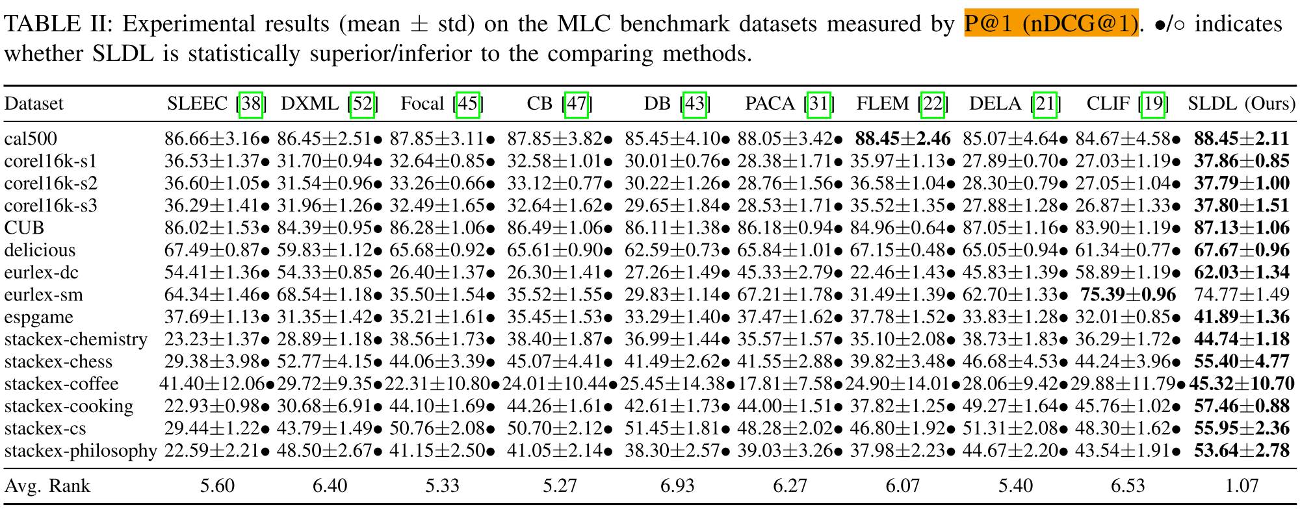
Evaluation Metrics

Slide 26
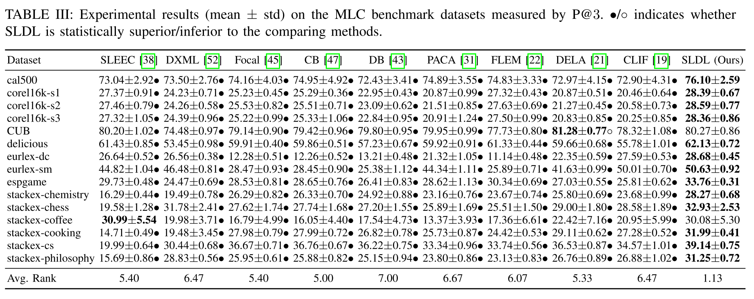
Evaluation Metrics

Slide 27
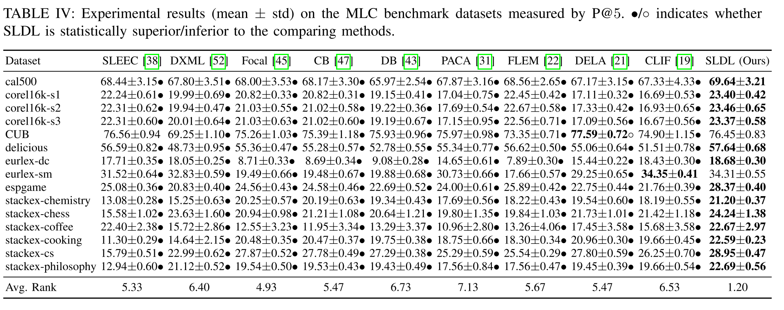
Evaluation Metrics

Slide 28
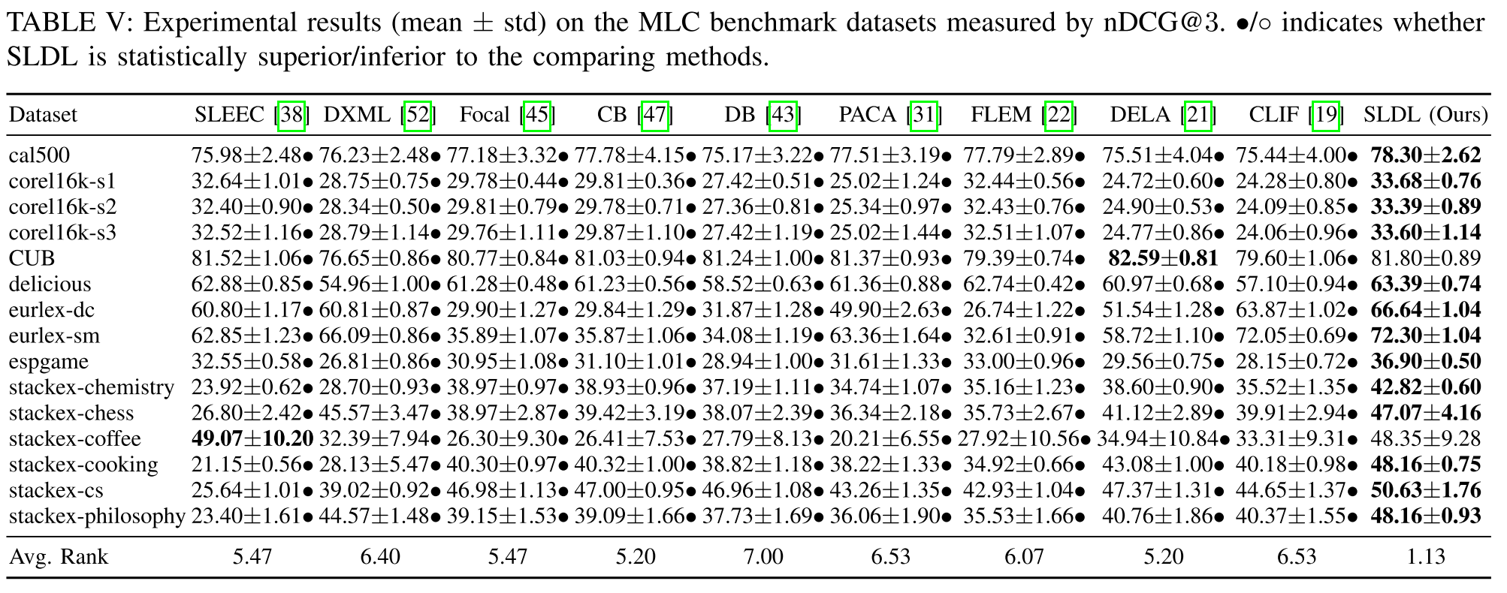
Evaluation Metrics

Slide 29
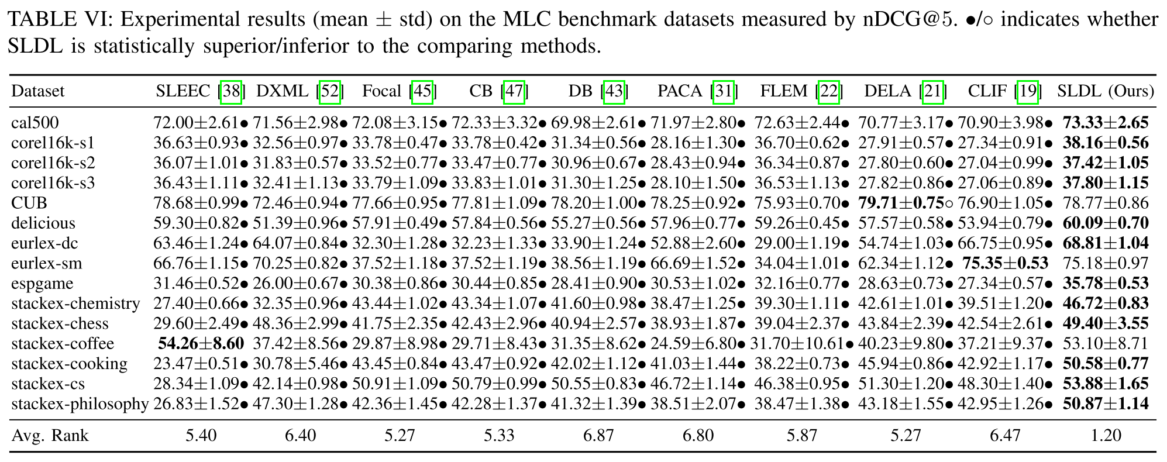
Evaluation Metrics

Slide 30
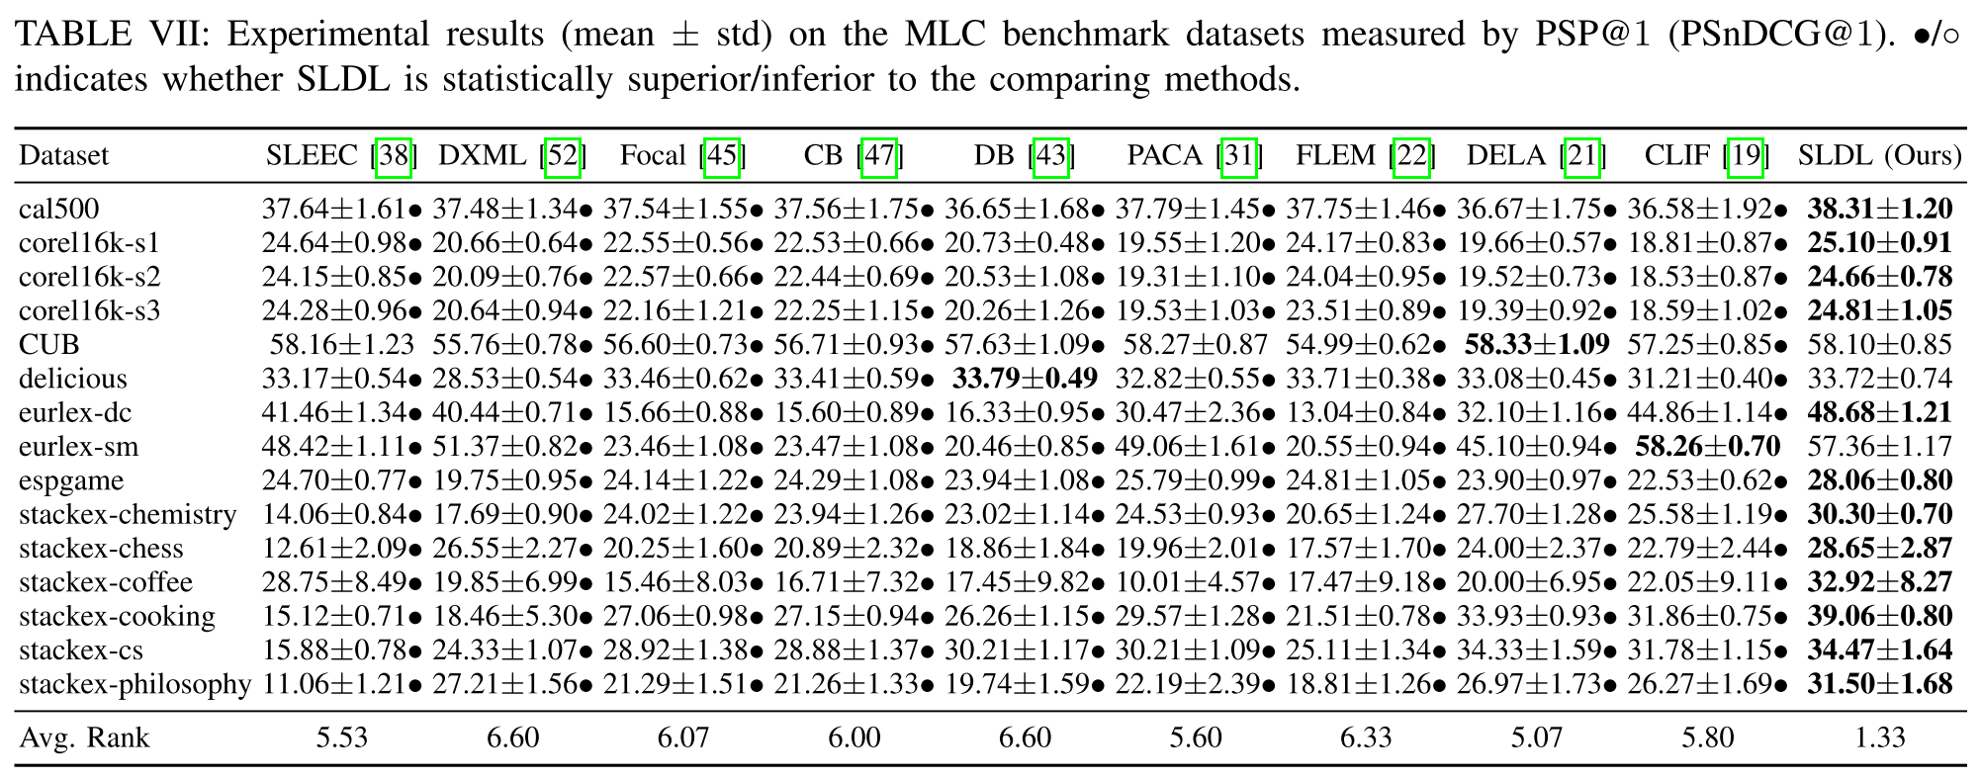
Evaluation Metrics

Slide 31
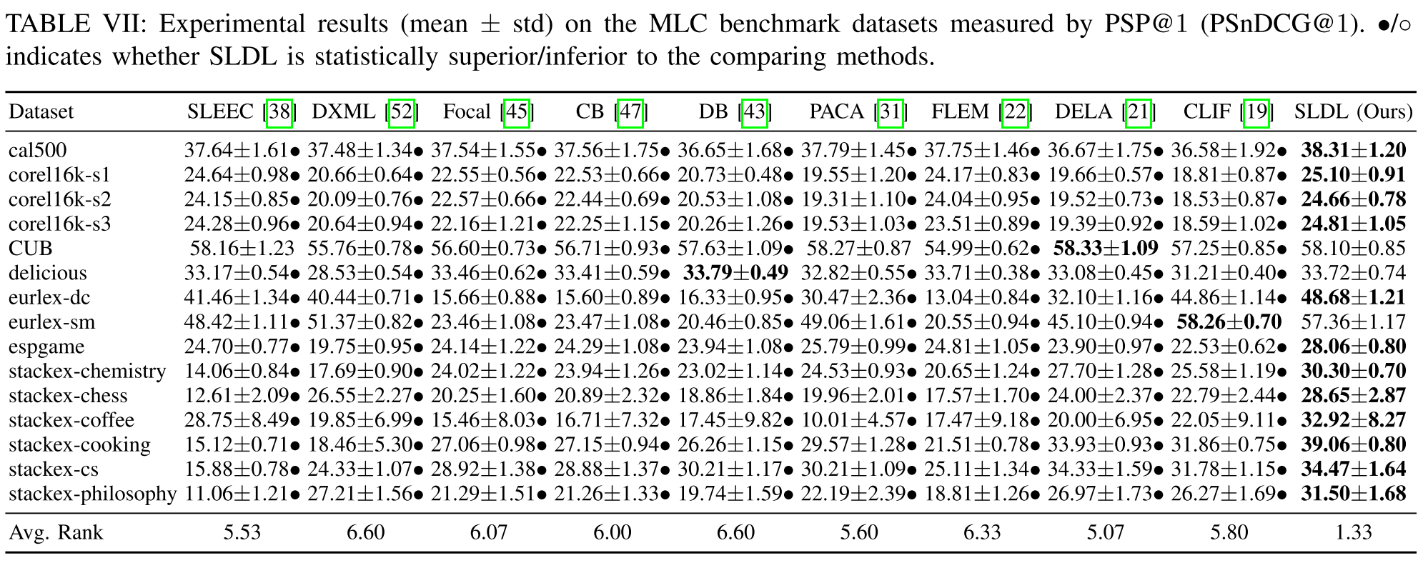
Evaluation Metrics

Slide 32
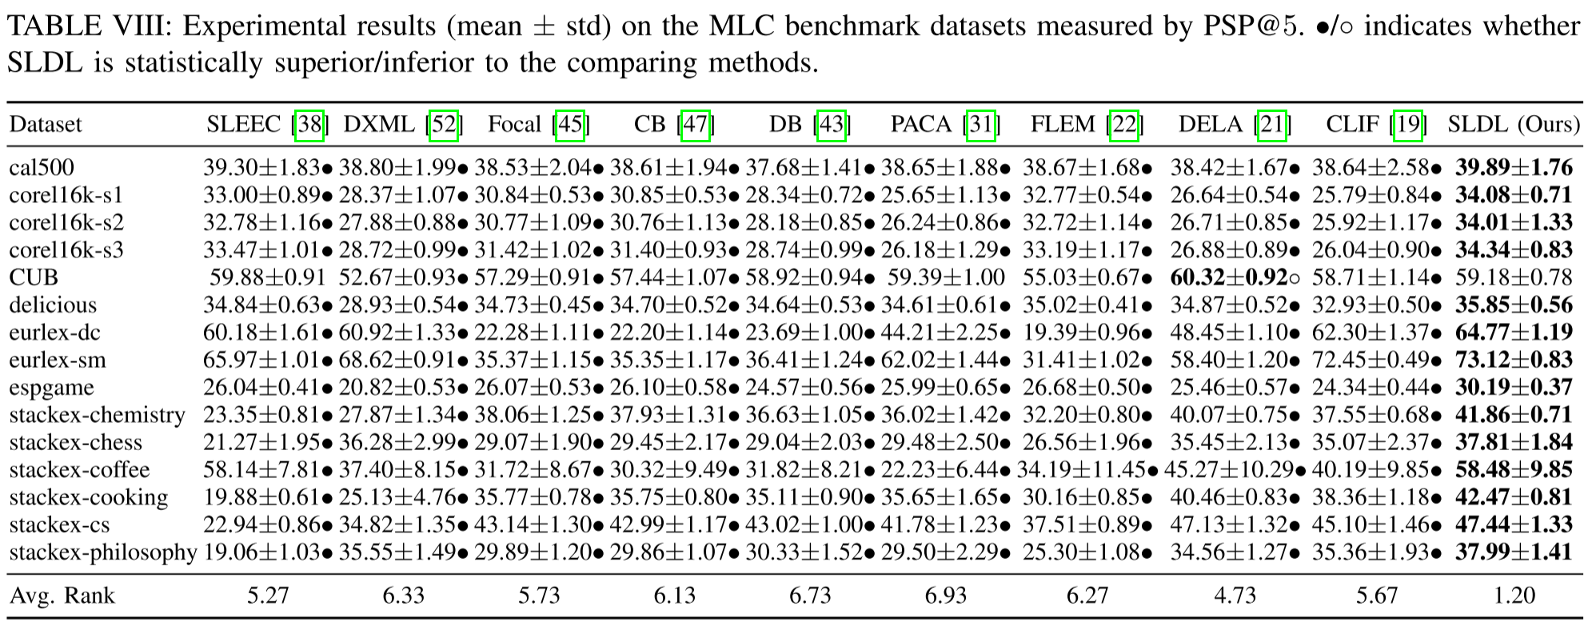
Evaluation Metrics

Slide 33
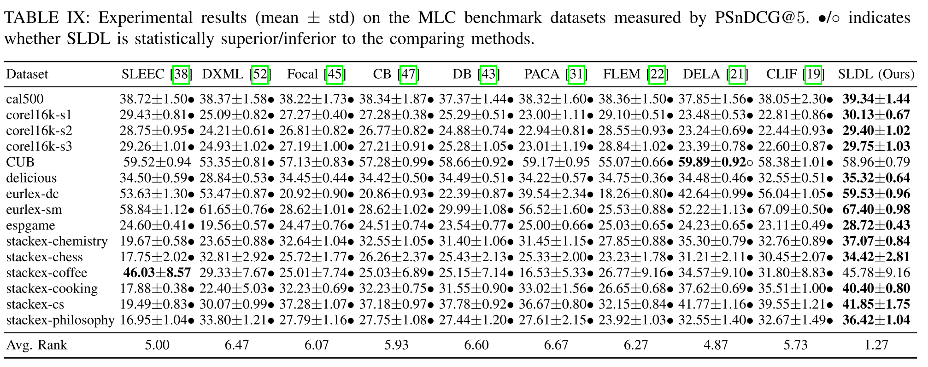
Evaluation Metrics

Slide 34
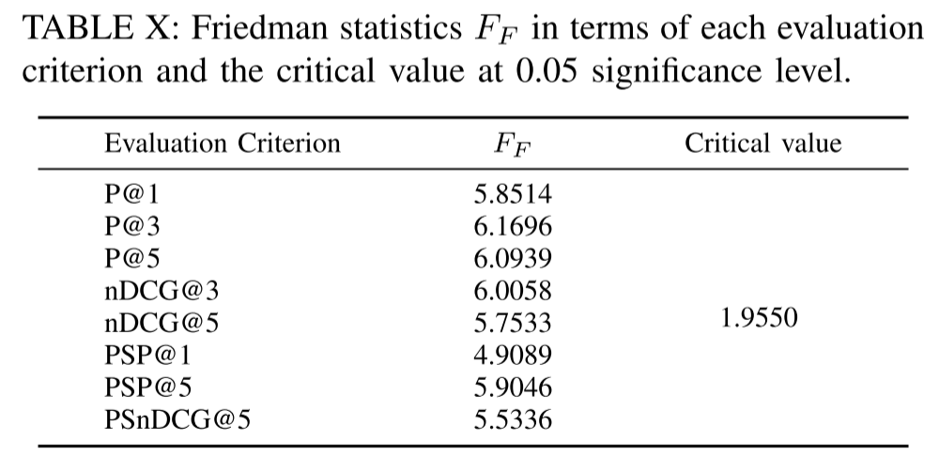
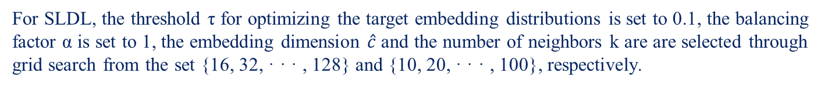
Performance Comparison
For SLDL, the threshold τ for optimizing the target embedding distributions is set to 0.1, the balancing factor α is set to 1, the embedding dimension $\hat{c}$ and the number of neighbors k are are selected through grid search from the set {16, 32, · · · , 128} and {10, 20, · · · , 100}, respectively.

Slide 35
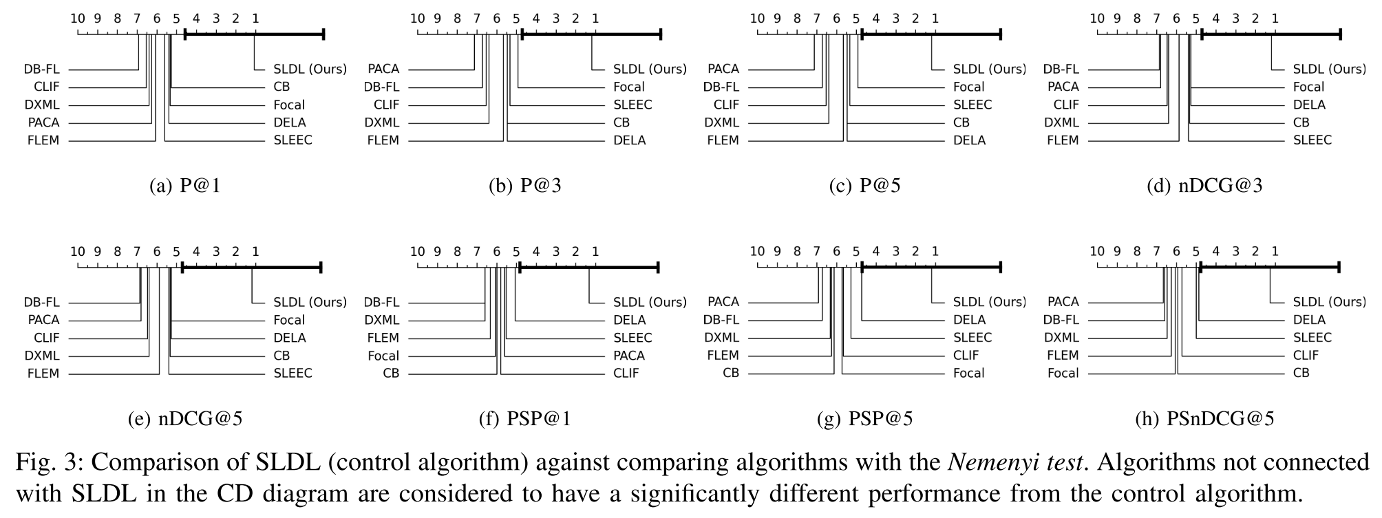
Performance Comparison

Slide 36
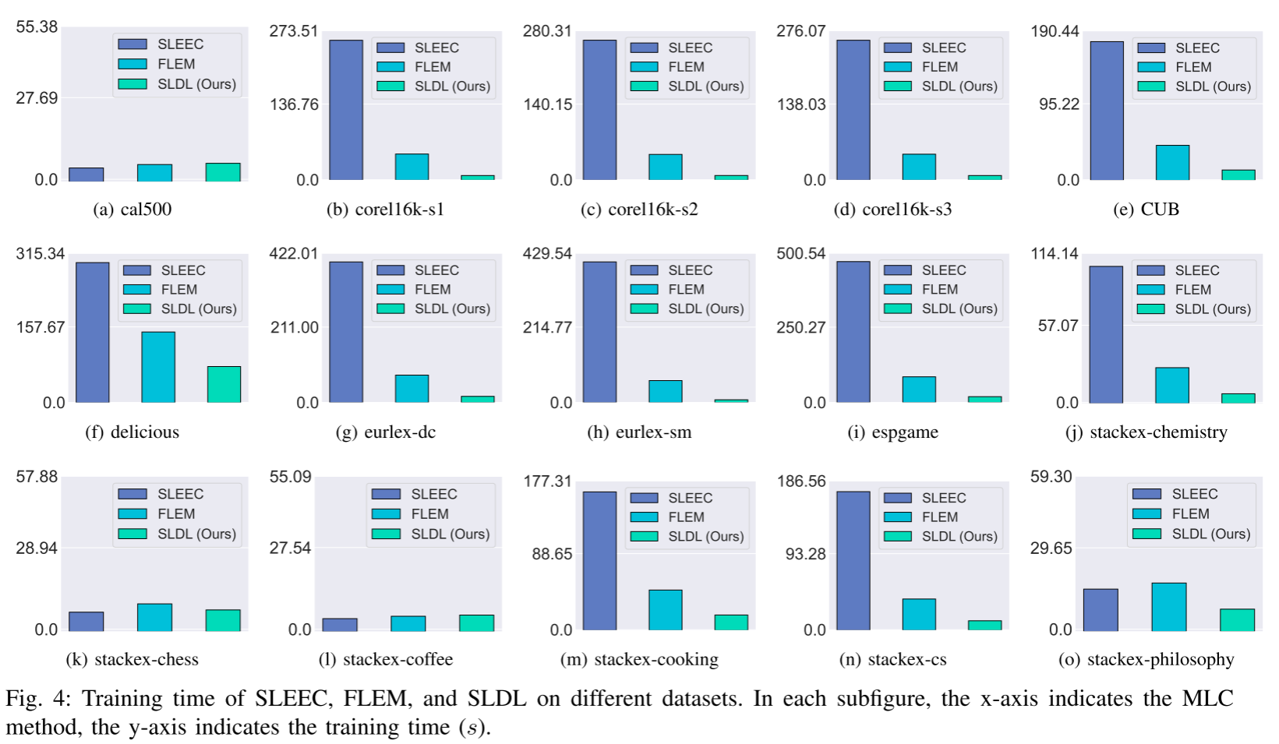
Analysis of Time Consumption

Slide 37
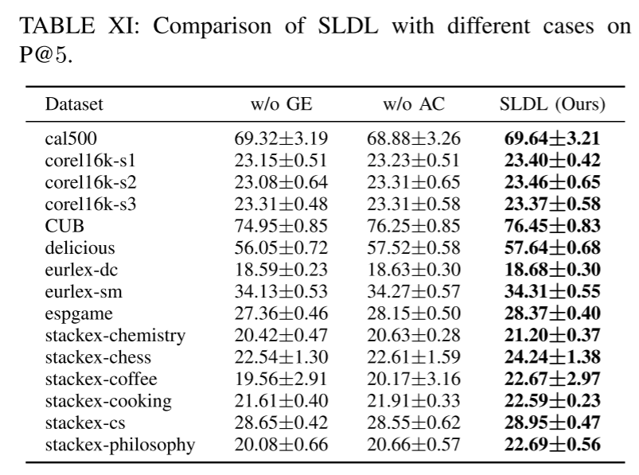
Ablation Study
Case 1 (w/o GE): without learning the Gaussian embedding
Case 2 (w/o AC): without learning the asymmetric correlation among different labels

Slide 38
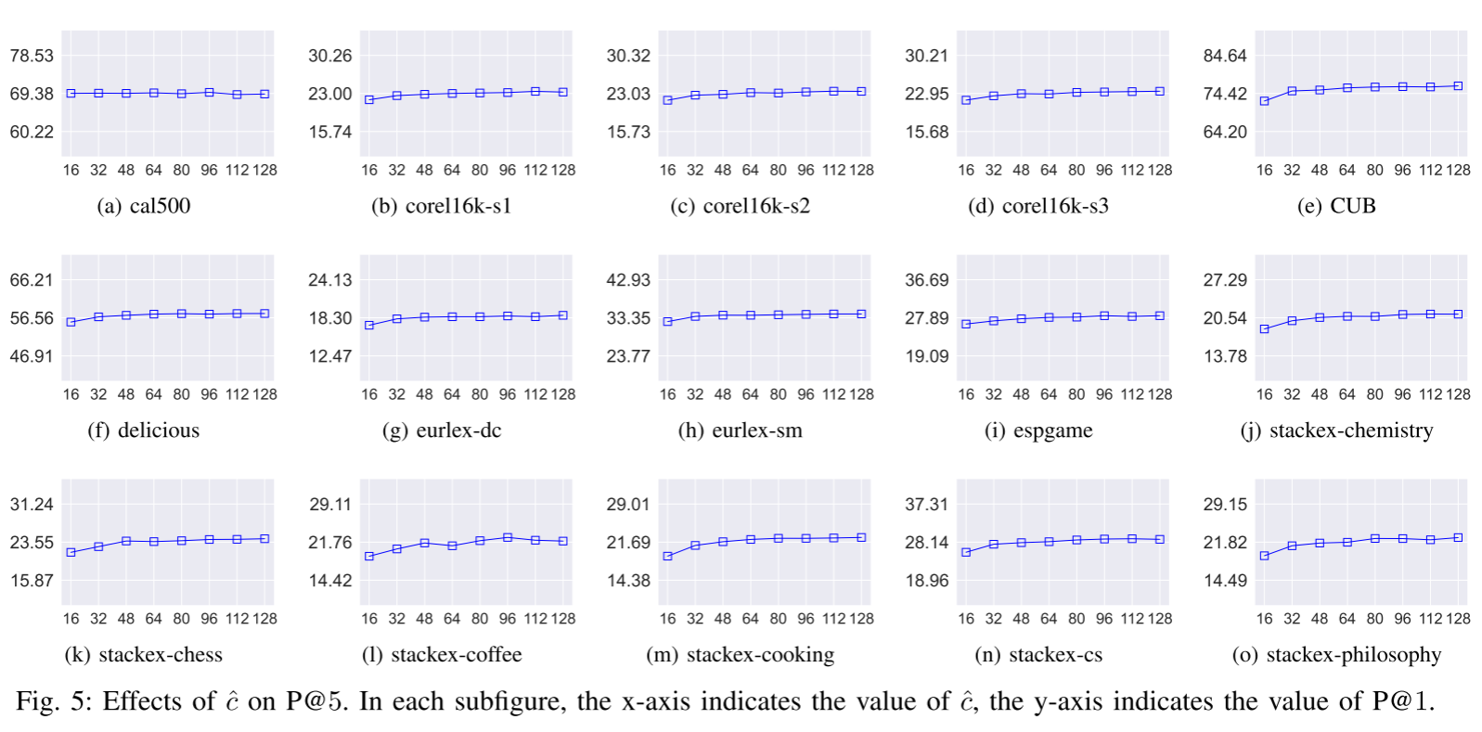
Ablation Study
Effect of Hyperparameters $\hat{c}$ and k

Slide 39
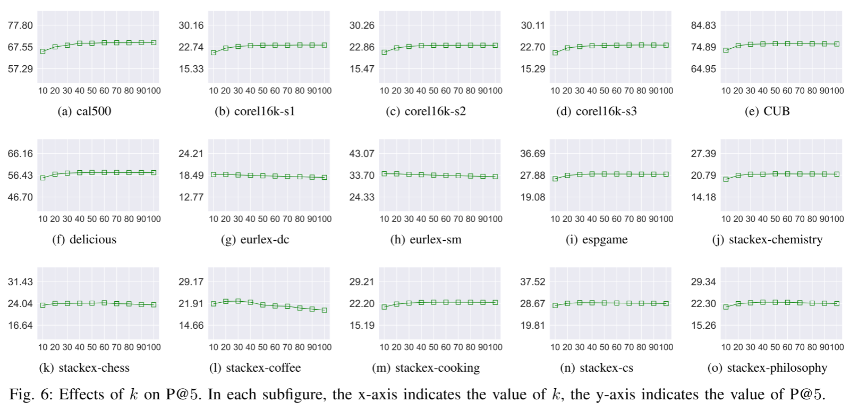
Ablation Study
Effect of Hyperparameters $\hat{c}$ and k

Slide 40
Table of Contents
1
Introduction
2
Related Work
3
Proposed Method
4
Experiments
5
Conclusion

Slide 41
Conclusion
It is a scalable and effective solution for multi-label classification tasks with a large output space.
It represents different labels in a potentially low-dimensional Gaussian embedding space and proposes a asymmetric metric to effectively capture the accurate relationships between different labels.
It introduces a simple yet effective method to learn the mapping from the feature space to the potentially low-dimensional embedding space, where the computational complexity is no longer related to the number of labels.

